Slide 1
DOM
Document object model

Slide 2
Introduction to the DOM
What is the DOM?
The DOM (Document Object Model) is a programming interface for HTML and XML documents.
It represents the document as a tree of objects, where each node is a part of the document (elements, attributes, text).
With the DOM, you can access and modify the document’s structure, style, and content using JavaScript.
Changing the HTML content via Javascript
<!DOCTYPE html>
<html>
<body>
<h1 id="heading">Hello World</h1>
<script>
// Accessing an element in the DOM
const pageHeading = document.getElementById("heading");
// Changes the text content of the <h1> element
pageHeading.textContent = "Hello, DOM!";
</script>
</body>
</html>

Slide 3
Why Learn the DOM?
Why is the DOM Important?
The DOM serves as the bridge between HTML/CSS and JavaScript, enabling the creation of dynamic and interactive web pages.
It allows developers to modify content, structure, and styles on the fly.
Essential for creating modern web applications where user interactions, animations, and updates happen without reloading the page.

Slide 4
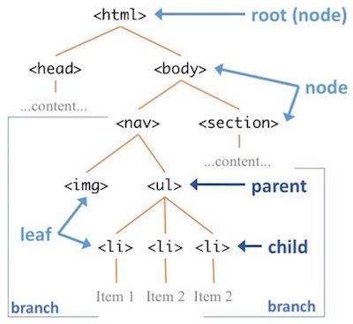
DOM Structure Overview
DOM Tree Structure
The DOM represents the document as a hierarchical tree structure.
The root node is the document, with other nodes like elements (<div>, <p>), attributes, and text.
Relationships: Each node can have parents, children, and siblings, forming a tree-like structure.
Visualizing the DOM as a tree helps understand how to navigate and manipulate different parts of the document.

Slide 5
Core Concepts of the DOM
Core DOM Concepts
Nodes: Basic building blocks of the DOM (Element nodes, Text nodes, Attribute nodes).
Elements: HTML tags like <div>, <span>, <p> are element nodes.
Attributes: Provide additional information about elements, like id, class, etc.
Events: Actions that occur when a user interacts with the webpage, like clicks or keypresses.

Slide 6
Accessing the DOM
Accessing the DOM
Several methods allow you to select elements in the DOM:
getElementById() - Selects an element by its unique ID.
getElementsByClassName() - Selects elements by their class name.
querySelector() - Selects the first element that matches a CSS selector.
querySelectorAll() - Selects all elements that match a CSS selector.

Slide 7

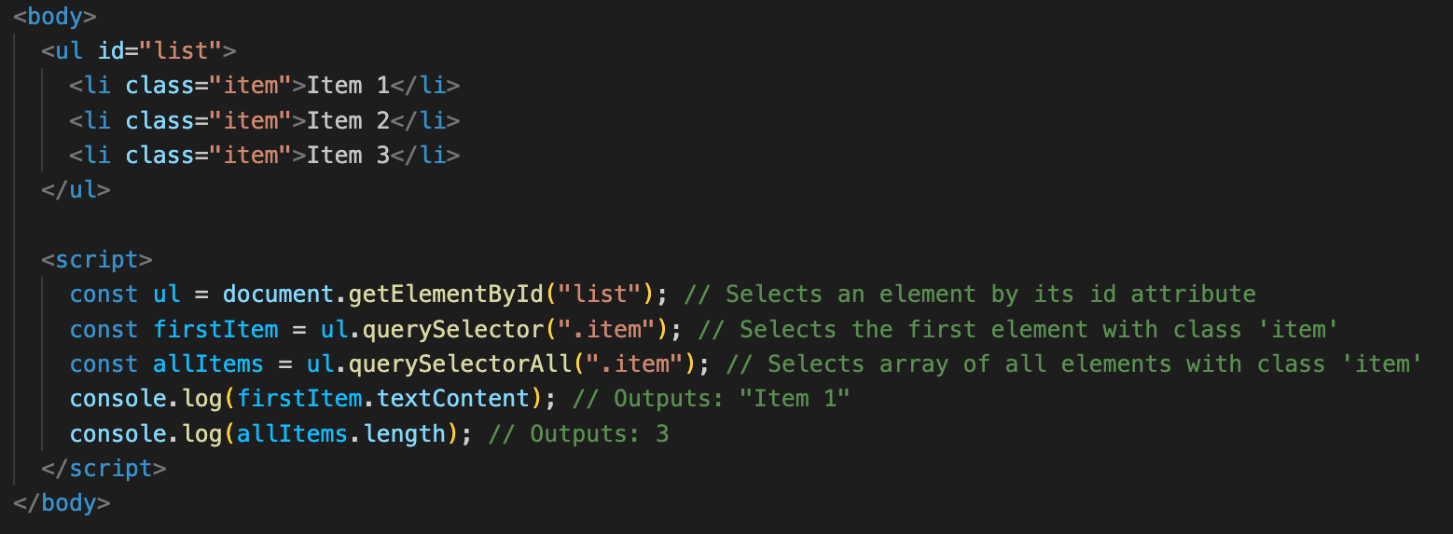
Accessing the DOM

Slide 8
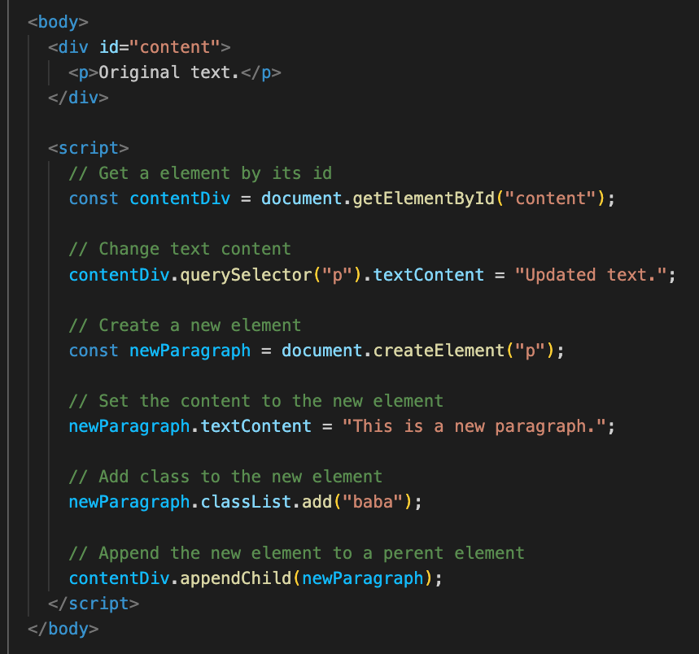
Manipulating the DOM
Manipulating the DOM
Modify content: textContent, innerHTML.
Change attributes: setAttribute(), classList.
Add or remove elements: createElement(), appendChild(), removeChild().
DOM manipulation is the core of dynamic and interactive web pages.

Slide 9
DOM Events
A deep dive into dom events

Slide 10
DOM Events: Introduction
What are DOM Events?
DOM events are actions or occurrences that happen in the web browser, such as clicking a button, typing in a text field, moving the mouse, or submitting a form.
Events provide a way to make web pages interactive by allowing JavaScript to execute code when users interact with the page.

Slide 11
DOM Events: Introduction
Why Are DOM Events Useful?
Events are crucial for building dynamic, interactive web applications.
They allow you to respond to user interactions, enabling functionalities like form validation, dropdown menus, and live content updates.
By handling events, you can create a seamless user experience.

Slide 12
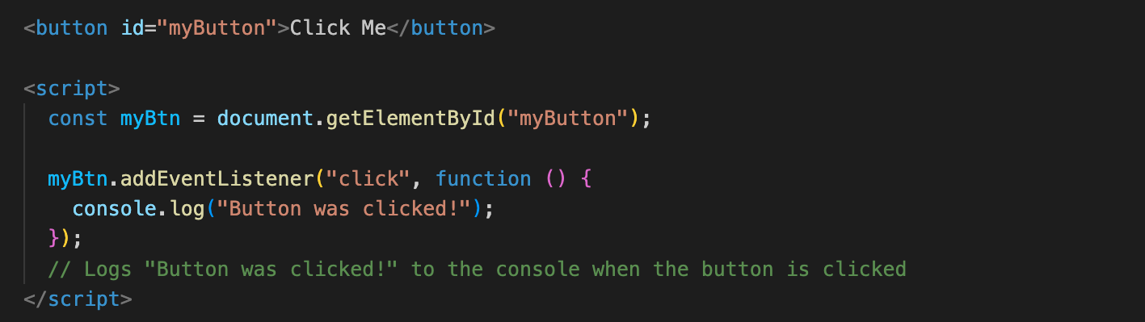
DOM Events: Introduction
Common DOM Events:
Click: Triggered when an element is clicked.
Submit: Triggered when a form is submitted.
Mouseover: Fired when the mouse pointer enters an element
Resize: Triggered when an element is resized.

Slide 13
How DOM Events Work
Event Listeners
An event listener is a procedure in JavaScript that waits for an event to occur on an element.
You can use addEventListener() to attach an event listener to an element, specifying the event type (e.g., 'click') and a function (callback) to execute when the event occurs.

Slide 14
But wait a minute…
Callback function? What are you even talking about?!

Slide 15

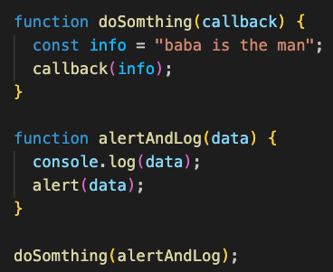
Callbacks: The Core of Event Handling
What are Callback Functions?
A callback function is a function passed as an argument to another function.
In the context of DOM events, callbacks define what happens when an event occurs.
When you add an event listener, you pass a callback function that gets executed whenever the specified event occurs.

Slide 16
Callbacks The Core of Event Handling
Why Use Callback Functions in Event Handling?
Callbacks allow you to define the exact behavior that should occur when an event happens.
They make the code modular and reusable by separating the logic of event handling from the rest of the code.
Simple Explanation:
Think of a callback function as a "to-do" list given to the event listener.
When the event happens, the event listener checks the "to-do" list (callback function) and executes it.

Slide 17
Adding and Removing Event Listeners
Adding Event Listeners with addEventListener
addEventListener attaches an event handler to an element.
It takes two arguments: the event type (e.g., 'click') and a callback function.
Multiple event listeners can be added to the same element.
Removing Event Listeners with removeEventListener
removeEventListener removes an event listener, stopping the callback from executing when the event occurs.
You must pass the same function reference used in addEventListener to remove it.

Slide 18
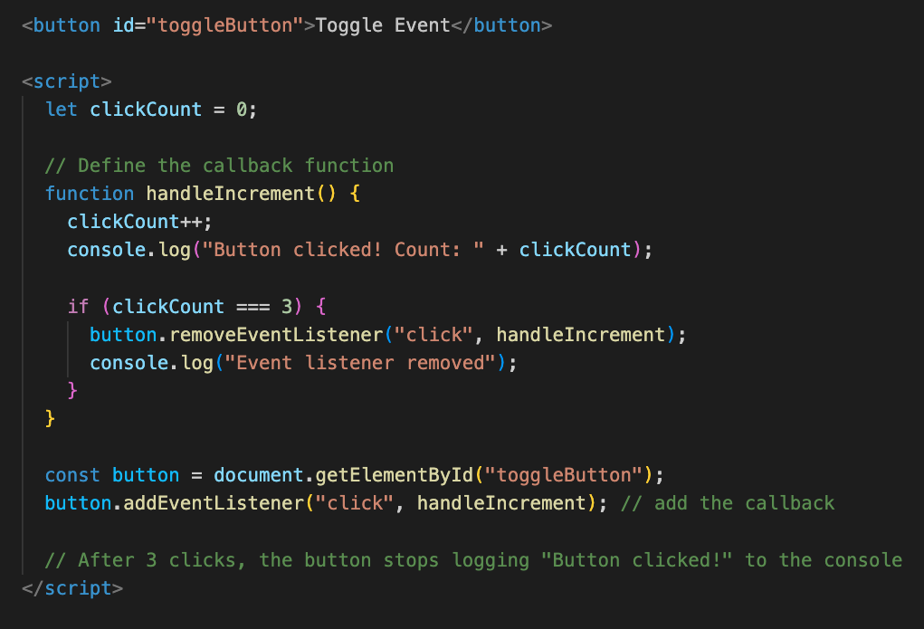
Adding and Removing Event Listeners

Slide 19
Adding and Removing Event Listeners
Explanation:
clickCount is a global variable initialized to 0.
handleIncrement:
Increments the clickCount variable each time it's called.
Logs the click count to the console.
If clickCount reaches 3, it removes itself as an event listener from the button element and logs that the event listener has been removed.
addEventListener attaches the handleIncrement function to the button's click event.
After the third click, the event listener is removed, and clicking the button will no longer trigger the handleIncrement function.

Slide 20
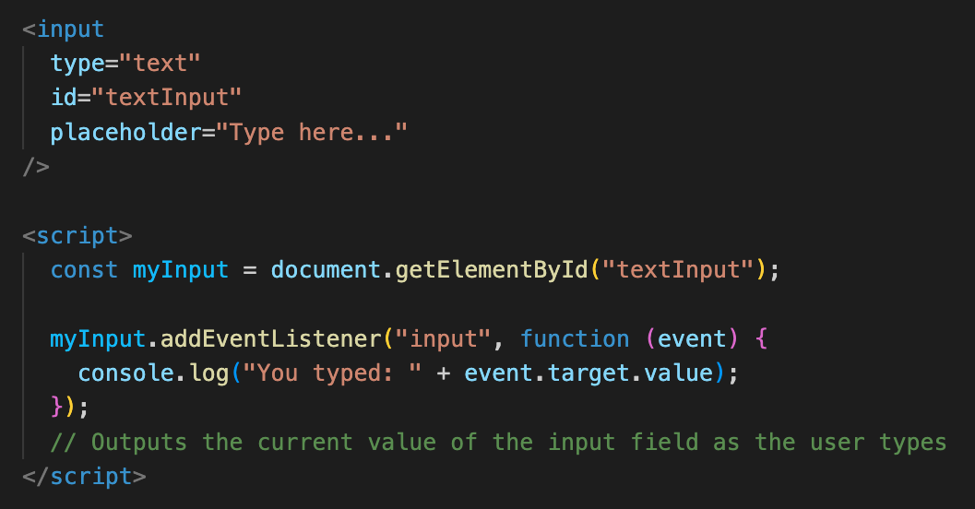
How DOM Events Work
Event Object
When an event occurs, an event object is automatically passed to the event handler (callback function).
This object contains information about the event, such as its type and the element that triggered it.

Slide 21
Event Propagation
Understanding Event Propagation
Event propagation refers to the order in which events are received in the DOM.
There are two phases: Event Capturing (from the root to the target) and Event Bubbling (from the target to the root).
By default, most events propagate in the bubbling phase, but this behavior can be controlled.

Slide 22
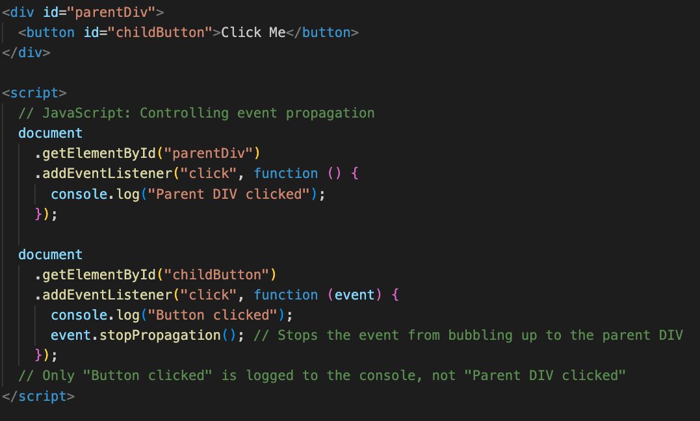
Event Propagation
Stopping Event Propagation
Use event.stopPropagation() within a callback to stop the event from bubbling or capturing further.

Slide 23
Event: Conclusion
Conclusion
DOM events are essential for creating interactive web pages.
Understanding how events work and how to use callback functions enables you to build more dynamic and user-friendly web applications.
By using event listeners and handling event propagation correctly, you can create complex interactive behavior on the web.

